Slide 1


Java SE
(Core JAVA)
Lecture-5

Slide 2
Today’s Agenda
Operators
Displaying values of variables
Concatenating using operator “+”
Concept of Default values
Program to calculate Circumference and Area of circle

Slide 3
Operators
Arithmetic
Relational
ShortHand
Logical
Pre/
Post
Misc
+
-
*
/
%
>
<
>=
<=
==
!=
+=
-=
*=
/=
%=
&&
||
!
++
- -
instanceof
Assignment
=

Slide 4
Few Important Points
The division operator in Java , just like C language uses two kinds of division :
Integer Division : if both operands(Numerator and Denominator) are integers then result will also be an integer. So 10/4 is 2 not 2.5
Floating Division: if either operands (Numerator or Denominator or both) are float or double then result will also be float or double. So 10/4.0 is 2.5

Slide 5
Few Important Points
The modulo division operator( % ) in Java , unlike C , works with float and double data type also.
So 10%5 will produce 0 as the remainder
So 10.5 %5.0 will produce 0.5 as the remainder

Slide 6
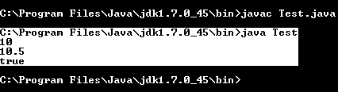
Displaying Values of Variables
class Test
{
public static void main(String args[])
{
int a=10;
double b=10.5;
boolean c=true;
System.out.println(a);
System.out.println(b);
System.out.println(c);
}
}
Hence, the same println() used for all data types i.e. println() is an overloaded function.

Slide 7
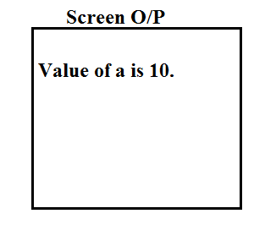
Displaying value with message
class Test
{
public static void main(String args[ ])
{
int a=10;
System.out.println(“Value of a is”+a);
}
}
String
variable
Concatenates string and variables

Slide 8
Polymorphic Behaviour of “+”
Rule : anything concatenated with a String becomes String otherwise normal addition will be done
Some more examples :-
“10” + “5”
“10” + 5
10 + “5”
.5 + .1+“10”
“10” + .5+.1
105
105
105
.610
10.5.1

Slide 9
Concept of default values
Before we can understand what is the default value of a variable, we must first understand how many types of variables java supports.
In Java , we have 3 kinds of variables:
Local variables
Class Level variables(also called as Instance members)
Static variables( we will discuss them with the chapter “Static”)

Slide 10
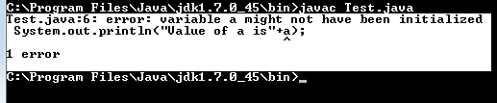
Concept of default values
Local variables
Variables declared in a method are called local variables.
These variables cannot be left unassigned else compiler generates error.
class Test
{
public static void main(String args[])
{
int a;
System.out.println(“Value of a is”+a);
}
}
Error

Slide 11

Concept of default values
Class level Variables :-
Variables which are declared in a class but not inside a particular method.
If these variables are left unassigned then they are assigned with default value 0 or false, depending on their data type.
class Student
{
int roll;
.
.
public void show( )
{
System.out.println(“Roll is"+roll);
}
.
.
.
}

Slide 12
Default Values Chart
Data Type | Default Value
boolean | false
char | \u0000 or simply ‘\0’
int,short,byte / long | 0 / 0L
float /double | 0.0f / 0.0d
any reference type | null
Remember that these values are for class level variables i.e. instance members not for local variables. Local variables in java do not have any value not even “garbage value”!

Slide 13
Try this
Write a program to calculate area and circumference of a circle. Assume radius to be an integer and assign it any value of your choice.

Slide 14
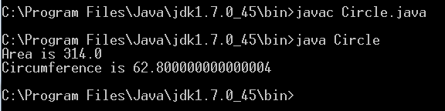
Solution
class Circle
{
public static void main(String [ ] args)
{
int r=10;
double area,circ;
area=3.14*r*r;
circ=2*3.14*r;
System.out.println("Area is "+area);
System.out.println("Circumference is "+circ);
}
}

Slide 15
Using “Math” class
Java has a predefined class called “Math”
The class is available in the package java.lang and contains
methods for performing basic numeric operations like
exponential, square root , trigonometric functions etc
Within the Math class there is a static data member called
PI which returns the pi value of 3.141592653589793

Slide 16
Using “Math” class
Since PI is static , we can access it without creating any object
of Math class.
The syntax for accessing PI is : Math.PI

Slide 17
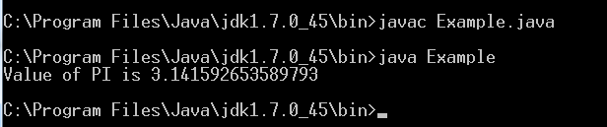
Using “Math” class
class Example
{
public static void main(String[] args)
{
System.out.println(“Value of PI is "+Math.PI);
}
}
Output:

Slide 18
Using “Math.pow( )”
Math class also contains a static method called pow( )
which returns the value of the first argument raised to the
power of the second argument.
Syntax of calling the method pow( ) is : Math.pow(a,b)
For example:
System.out.println(“Result is:”+Math.pow(2,3));
Output:
Result is 8.0

Slide 19
Try this
Can you improve the Circle program using the Math class ?

Slide 20
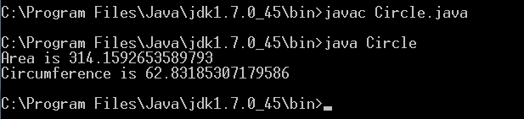
Improvised version Using Math class
class Circle
{
public static void main(String [ ] args)
{
int r=10;
double area,circ;
area=Math.PI*Math.pow(r,2);
circ=2*Math.PI*r;
System.out.println("Area is "+area);
System.out.println("Circumference is "+circ);
}
}

Slide 21

End Of Lecture 5
For any queries mail us @: scalive4u@gmail.com
Call us @ : 0755-4271659, 7879165533
Agenda for Next Lecture:
Accepting Input – Its Types
Accepting Input through Command Line Arguments
Wrapper Classes

